Slide 1
בס"ד Cryptography Project
Safe, secret based computation system.
Authors:
Nir Amar, Etai Hazan and Yarden Eitan.

Slide 2
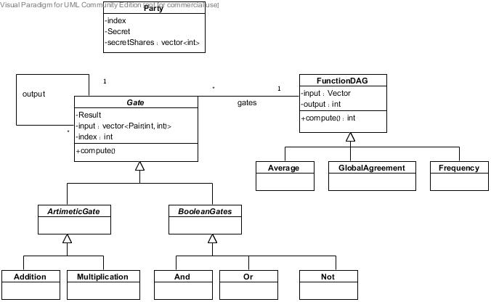
System Design & implementation first design

Slide 3
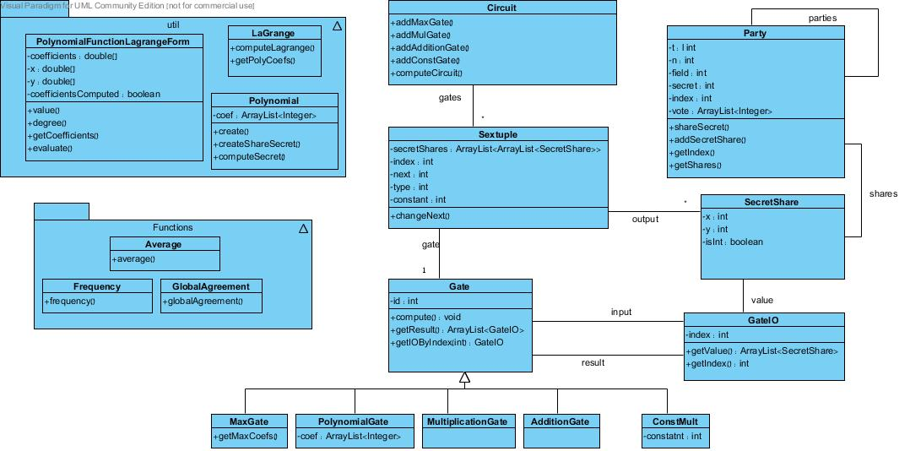
System Design & implementation final design

Slide 4
Graph Representation
Each arithmetic gate is a node in the graph
Directed edge from node A to node B exists if the output of arithmetic gate A is the input of the arithmetic gate B.
Class Sextuple contains:
Reference to gate.
2-dimensions array of secret shares - input
index of the gate
index of the output gate
type of the gate
array of secret share – output
constant – relevant only for constMult gate
Notes:
Reference to gate.
2-dimensions array of secret shares – the input for the gate
index of the gate
index of the output gate – index of the gate that the output vector will be deliver to
type of the gate - //0 = addition, 1 = multiplication, 2 = constmult, 3 = maximum
array of secret share – output – the result after the gate has been calculated
constant – relevant only for constMult gate – the constant of the constMult gate

Slide 5
Graph Computation
Define a topological sort on the graph to solve synchronization problems (done by the programmer).
Compute the function by the topological order.
Three phases:
Calculation
Update output
Update next sextuple input
Notes:
The topological sort done by inserting the gates to the circuit in the right order.
The computation is according to the indexes of the gates
Three phases:
Calculation – calculate the output according to the input and the type of the gate (use compute())
Update output – assign the result to output
Update next sextuple input – find next sextuple according to next index and initialize its input.

Slide 6
Functions
Average.
Global Agreement.
Frequency.

Slide 7
Average - motivation
Useful for:
Average of a course, without knowing other peoples grades.
Average Salaries in a company, without knowing the other employees salaries.

Slide 8
Average - implementation
Average function represents by arithmetic gates:
level one - Addition gates.
Level 2 – local computation (1/n).

Slide 9
Average – Example
3 secrets – s1=1, s2=2, s3=3.
T=1, n = 3, field = 7.
secret shares for p1 (s1)
[(1,0)(2,6)(3,5)]
secret shares for p2 (s2)
[(1,0)(2,5)(3,3)]
secret shares for p3 (s3)
[(1,5)(2,0)(3,2)]

Slide 10
Average – Example
Local computation (addition gates):
P1 = [3,5]
P2 = [6,4]
P3 = [2,3]
Result = 6
Every party do local computation (1/numOfParties)
Average = 6/3 = 2

Slide 11
Average – Example
P1
P2
P3
(1,0)
(1,0)
(1,5)
(2,6)
(2,5)
(2,0)
(3,5)
(3,3)
(3,2)
+
+
+
(2,0)
(4,4)
(6,1)
+
+
+
(3,5)
(6,4)
(2,3)
6

Slide 12
Global agreement - motivation
Useful for:
For peace in the Middle East.
Global agreements in Business meetings.

Slide 13
Global agreement - implementation
Global Agreement function represents by Boolean gates:
And gates of all inputs.

Slide 14
Global agreement - Example
3 secrets – s1=1, s2=0, s3=1.
T=1, n = 3, field = 7.
secret share for p1 (s1)
[(1,0)(2,6)(3,5)]
secret share for p2 (s2)
[(1,5)(2,3)(3,1)]
secret share for p3 (s3)
[(1,4)(2,0)(3,3)]
Notes:
(s1*s2)*s3

Slide 15
Global agreement - Example

Slide 16
Frequency - Motivation
Useful for:
Knowing who is the winner in an election.
(Vector of bits)

Slide 17
Frequency – implementation
Phase 1 – input is Vector of integers. For each element(Candidate) run BGW with sum function.
Phase 2 – input is vector of sum of votes for each candidate. V[i] is the sum for candidate i.
From now on, no party (or t parties) can study anything from the Vector about the original secretes.
Give V to one of the parties. He will calculates the maximum of V.
Phase 3 – input – V(the sum vector), and the maximum. Compare (binary Compare) the maximum for each V[i]. If match found – return i.

Slide 18
Frequency – implementation
Notes:
S1 = [0,0,1]
S2 = [1,0,0]
s3 = [1,0,0]
לאחר החיבור וקטור של שלשות
שער המקס מקבל 2 שלשות ומחזיר 0 או 1 שמבטא מי יותר גדול.
a*z + (1-z)*b
בסוף קיבלנו שלשה וממנה נחשב את המקסימום.
מחבר כל אינדקס

